Slide 1

Kinect 2.0 Game
Team members:
John
Ray
Project Goals:
Create a game using Kinect 2.0 based on the classic Atari game “Super Breakout”.
Player Controls:
The player will use their body movements, moving left or right, to control a game paddle at the bottom of the screen that will use a ball to destroy a set of bricks.

Slide 2
Game Research
Why use the Kinect ?
What kind of project to create ?
How do Kinect movement controls work ?
How does the Kinect work with Unity ?
What equipment was needed to carry out project ?

Slide 3
Game Architecture
The game was developed using Unity and Visual Studio. The PC connects to the Kinect 2.0 via windows adaptor.
The game was originally controlled using the arrow keys and having gotten that working, the Kinect movement controls were integrated into the game.
The arrow keys can still be used to play the game as the Kinect controls only activate once the game senses the Kinect has been connected.

Slide 4
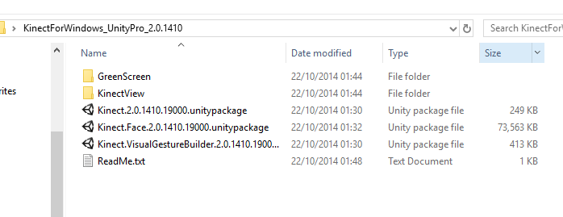
SDK & Unity Plugins
A new (2014) SDK for Kinect v2.
The old SDK was not compatible for v2 only worked for creating projects using the original Kinect.
KinectForWindows_UnityPro_2.0.1410 (plug in)
Only worked with Unity pro until the release of Unity 5

Slide 5

Installing Kinect on PC
USB 3 port
Kinect Studio v2.0
SDK Browser v2.0 (Kinect for windows)
Visual Gesture Builder

Slide 6
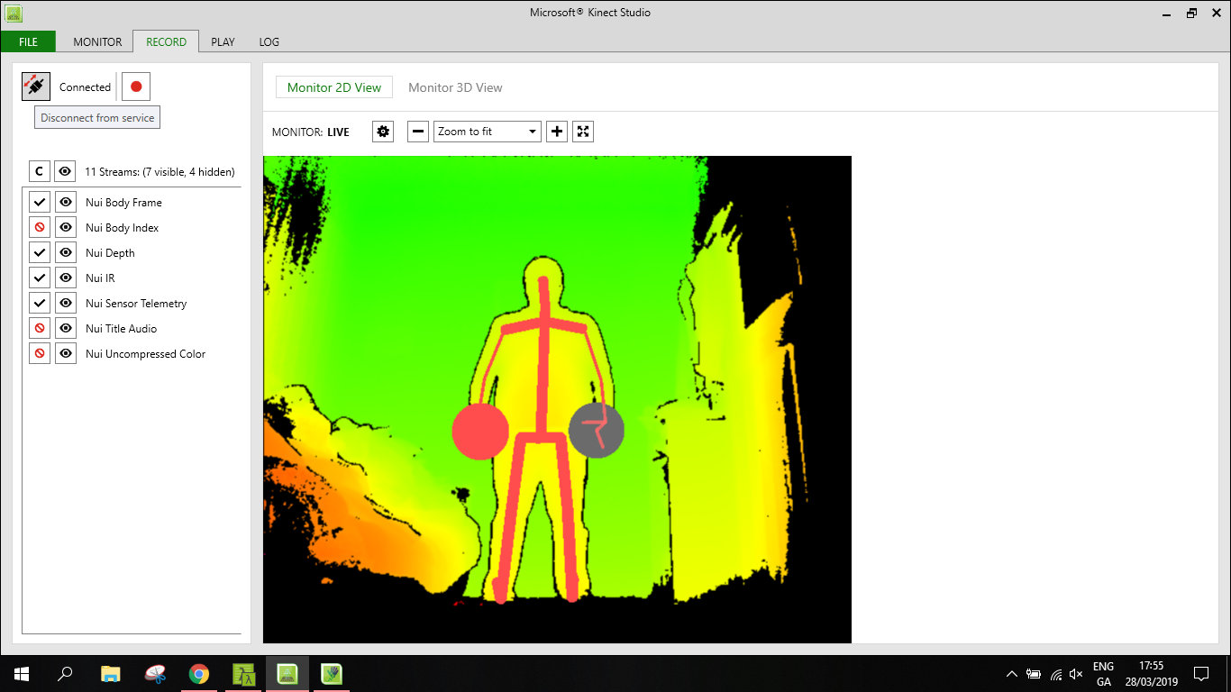
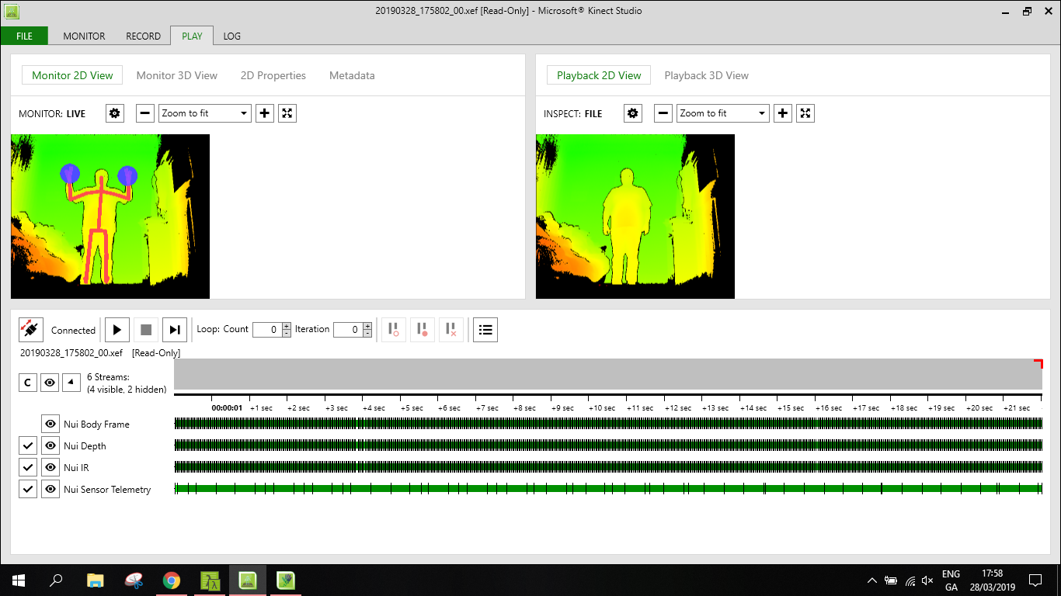
Recording Custom Gestures

Slide 7
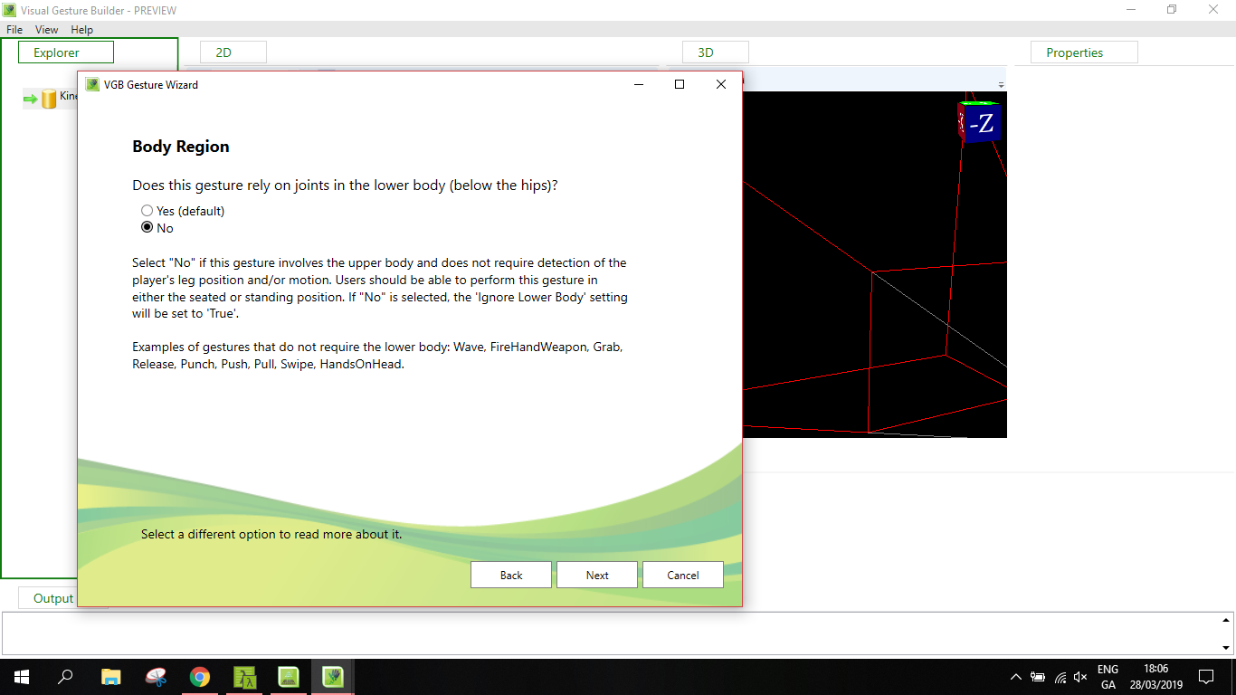

VGB Gesture Wizard

Slide 8


VGB Gesture Wizard

Slide 9
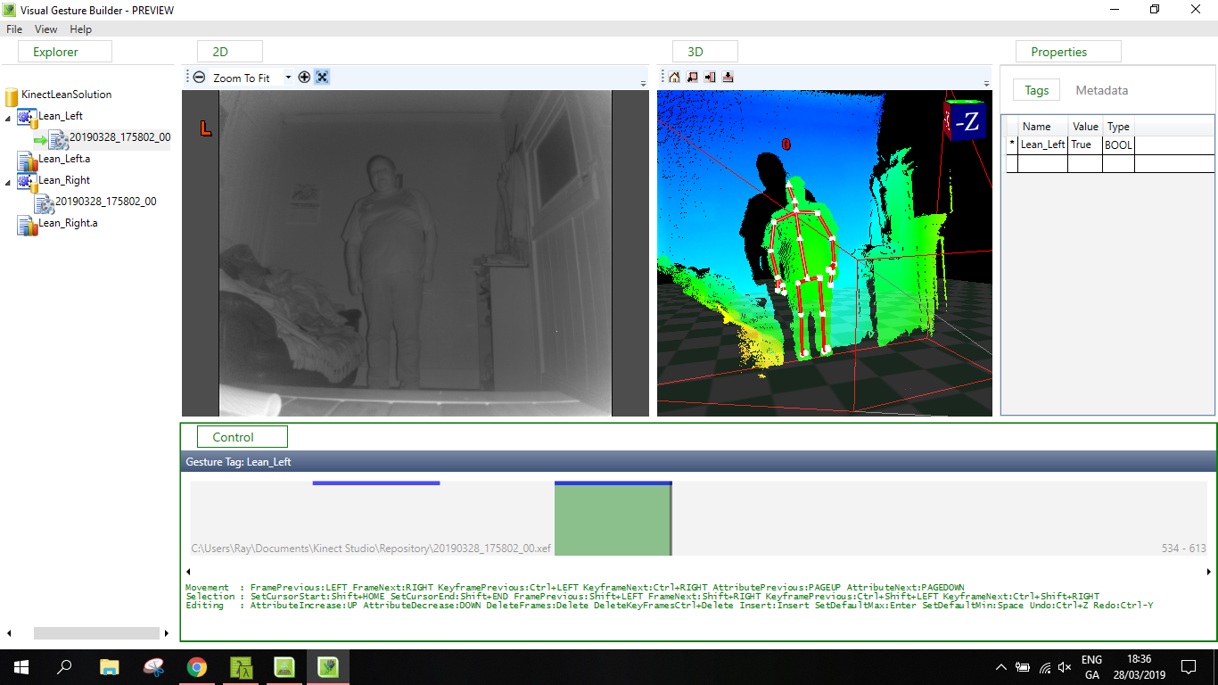
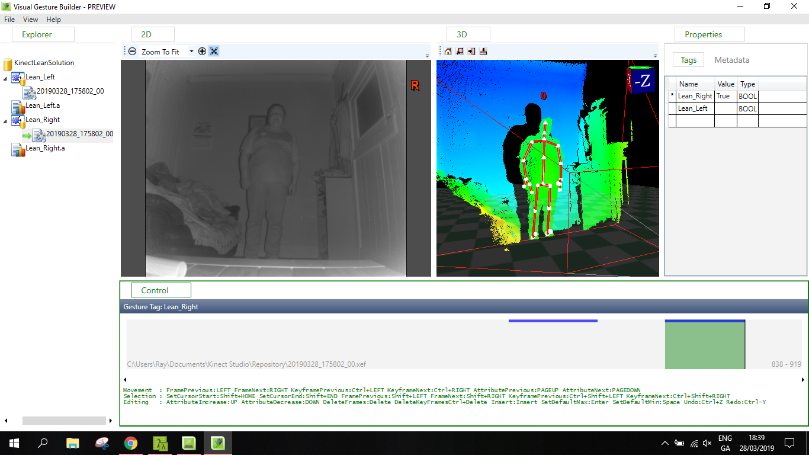
VGB Gesture Wizard

Slide 10
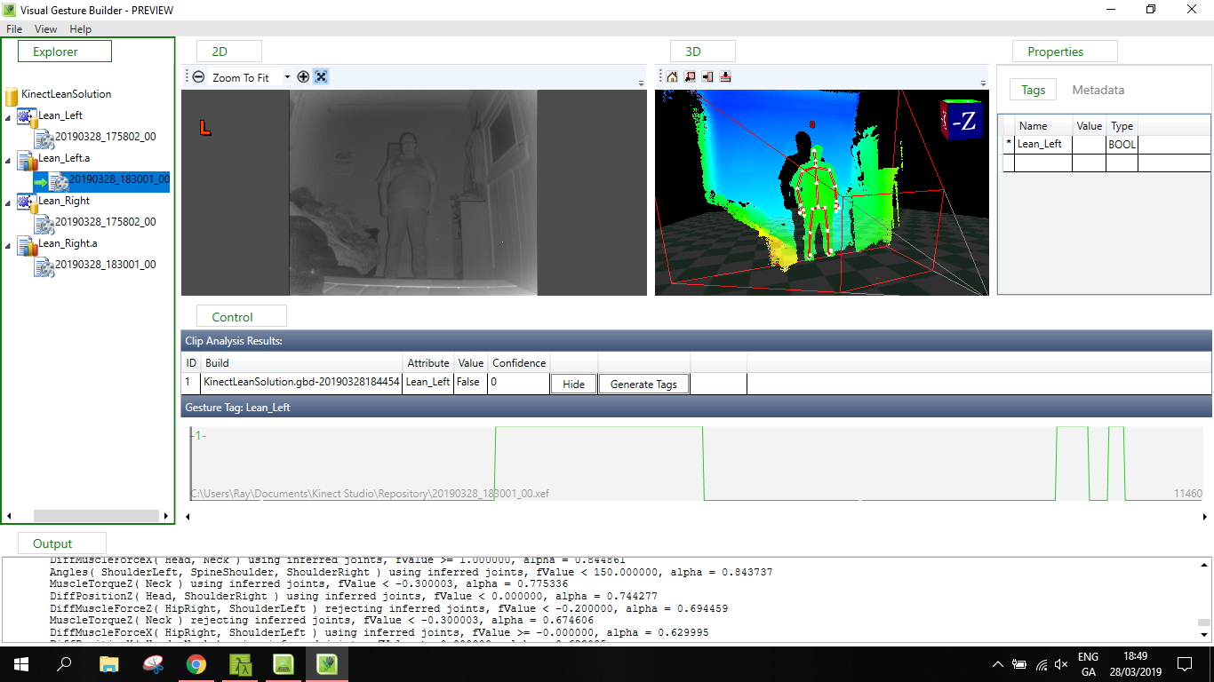
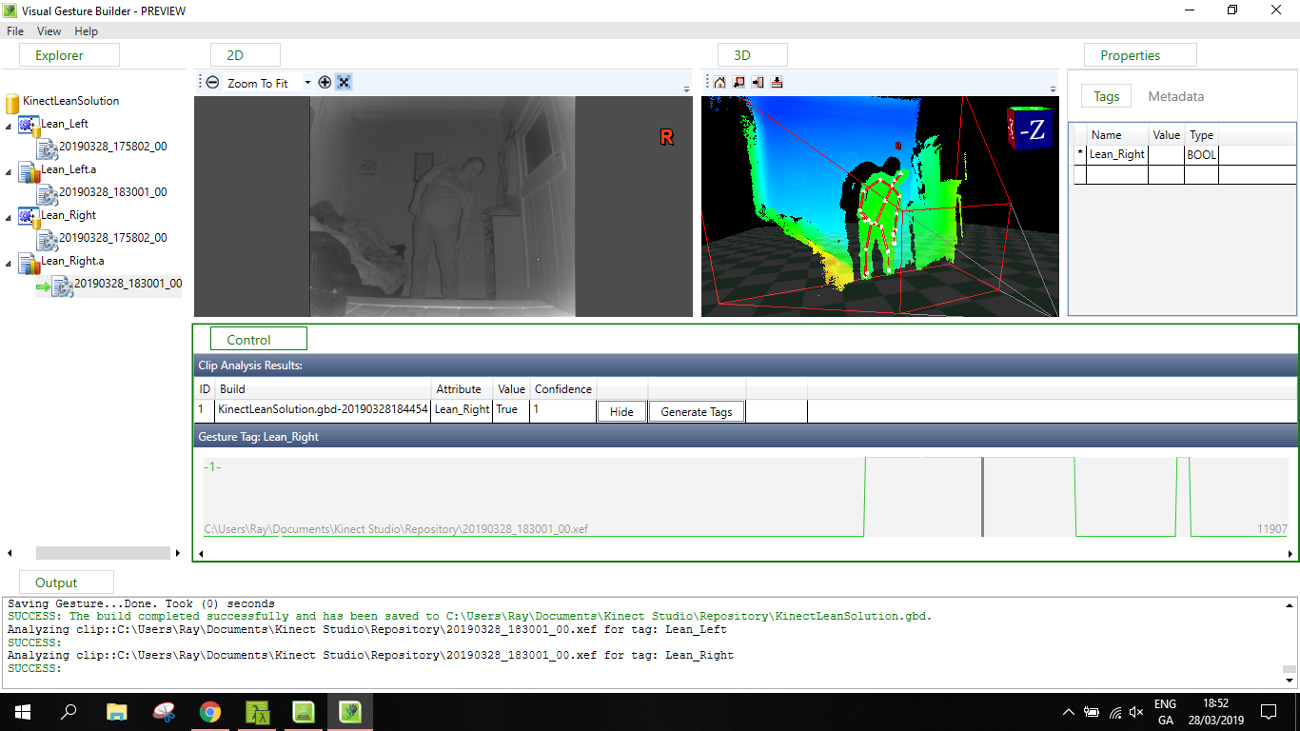
VGB Gesture Wizard

Slide 11
Adding Kinect to Unity
Import Kinect packages
Import the database of gestures that was created
Add a gesture detector script
Add a Kinect Manager
Alter scripts for the paddle

Slide 12
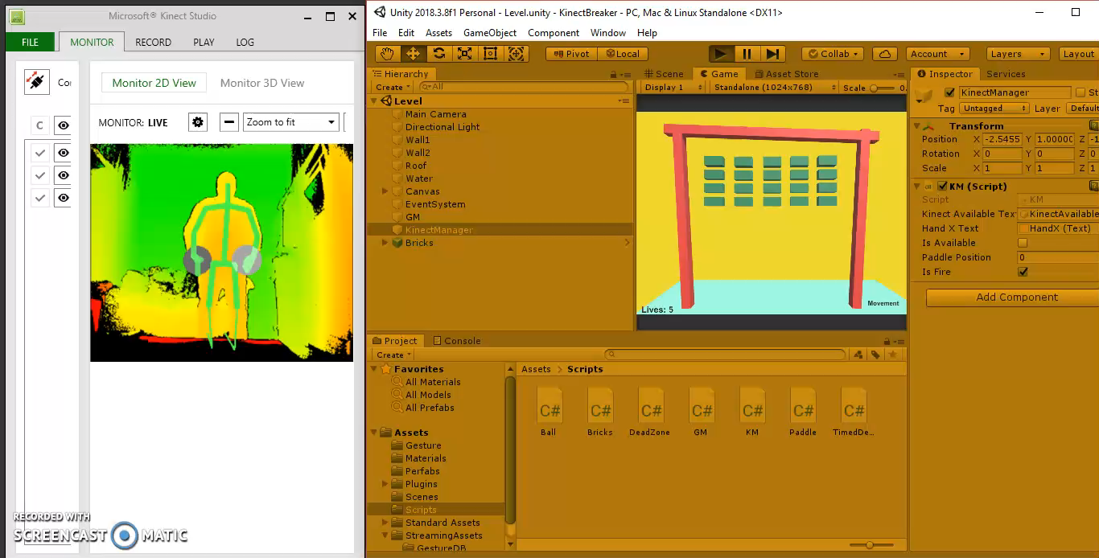
Game Video

Slide 13
Conclusions
Building a gesture database can be very time consuming.
Not a huge amount of examples for Kinect v2
It was an enjoyable project to work on but a more complex project, with more intricate movements i.e. dance revolution , could be very time consuming.

